Slide 1
Cloth Database
Naila Mammadova

Slide 2
Why we need this database
The database presented is created by small-scale retailers in order to record current status of sale. The database contains of different information of sold products, including its brand-name, size, price, color, product ID. Through this information, the retailer will be able to track dynamics of sales and can take adequate actions to further grow its business.

Slide 3
Creating Tables
We will use Microsoft SQL Server to accommodate our database.
The second step will be to create the database entitled “Cloth”.
The third step is to create several tables per category of attributes
There are four related tables exist in this database and in the following slides, we will encapsulate the details of each table.

Slide 4
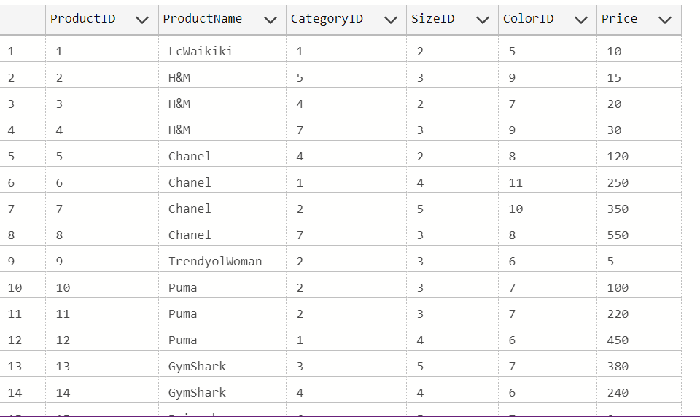
Product Table
The following code is to create table named “Product”. In this code, “Category ID, Size ID, ColorID” will be foreign key and will be referring to similar tables to get values. ProductID is the primary key for this table. Additionally, all attributes have been restricted of receiving any null values.
Create Table Product (ProductID INT IDENTITY (1,1) Not Null PRIMARY KEY,
ProductName Varchar(50) Not Null,
CategoryID INT Not Null REFERENCES Category(CategoryID),
SizeID INT Not Null References Size(SizeID),
ColorID INT Not Null references Color(ColorID),
Price INT NOt NULL)

Slide 5
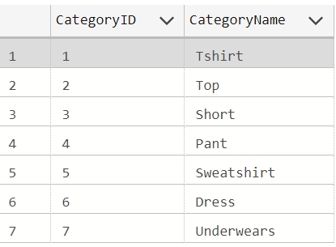
Category Table
The following code is to create table named “Category”. CategoryID is Primary Key in the meanwhile foreign key to Product Table. Both two attributes have been restricted to receive any null values. This table is primarily to classify category of sold products.
Create Table Category(CategoryID INT IDENTITY(1,1) Not Null Primary Key,
CategoryName Varchar(50) Not Null)

Slide 6
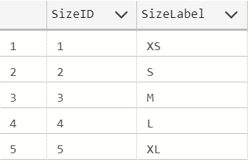
Size Table
The following code is to create table named “Size”. SizeID is Primary Key in the meanwhile foreign key to Product Table. Both two attributes have been restricted to receive any null values. This table is primarily to categorize size of sold products.
Create Table Size (SizeID INT IDENTITY(1,1) Not Null Primary Key,
SizeLabel Varchar(10) Not Null)

Slide 7
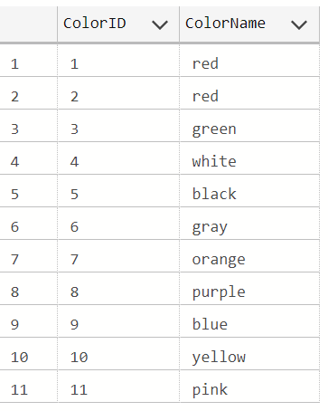
Color Table
The following code is to create table named “Color”. ColorID is Primary Key in the meanwhile foreign key to Product Table. Both two attributes have been restricted to receive any null values. This table is primarily to categorize size of sold products.
Create Table Color (ColorID INT IDENTITY (1,1) Not Null Primary Key,
ColorName Varchar(50) Not Null)

Slide 8
Business Questions
Question 1: What are available Product Names with Size Label greater than S?
Code: Select ProductName from Product as P
Where SizeID > 3
Question 2: Question 2: What are the average price for the product name 'TommyHilfiger’?
Code: Select AVG(Price) from Product
Where ProductName = 'TommyHilfiger’

Slide 9
Business Questions
Question 3: What is the most sold color of Zara brand?
Code: Select Top 1 ColorName as TotalSold from Color as C
Join Product as P
on c.ColorID = p.ColorID
Where ProductName = 'Zara'
GROUP BY Colorname
Question 4:What is the most expensive product name exist in Product Table?
Code: Select TOP 1 MAX(Price), ProductName from Product
Group By ProductName
Question 5: What is the most sold product name:
Code: SELECT TOP 1 ProductName, COUNT(*) as CountOfProduct
FROM Product
GROUP BY ProductName
ORDER BY COUNT(*) DESC;

Slide 10
Thank You

